Slide 1

Determining features predictive of short-term stock market opening price
Candidate paper towards the degree of M.S. Applied Artificial Intelligence
AAI-500-01-SU23 – Probability and Stats for AI
Team 5: Daniel Ackermann, Gary Takahashi and Akram Mahmoud
Shiley-Marcos School of Engineering, University of San Diego
Dr. Ebrahim Tarshizi
June 26, 2023
Notes:
This presentation is in support of the term paper towards a master’s degree in Applied Artificial Intelligence at the Shiley-Marcos School of Engineering, University of San Diego studying under Dr. Ebrahim Tarshizi. The team comprises of three students – Gary Takahashi, Akram Mahmoud, and my self, Daniel Ackermann. The title of the paper is, “Determining features predictive of short-term stock market opening price” where we looked at indicators to ascertain whether there are features that may indicate stock price changes for the next period.

Slide 2

Notes:
The question is, “Can we predict the future?”
Well, some would think we can with the stock market.
But is that true?

Slide 3
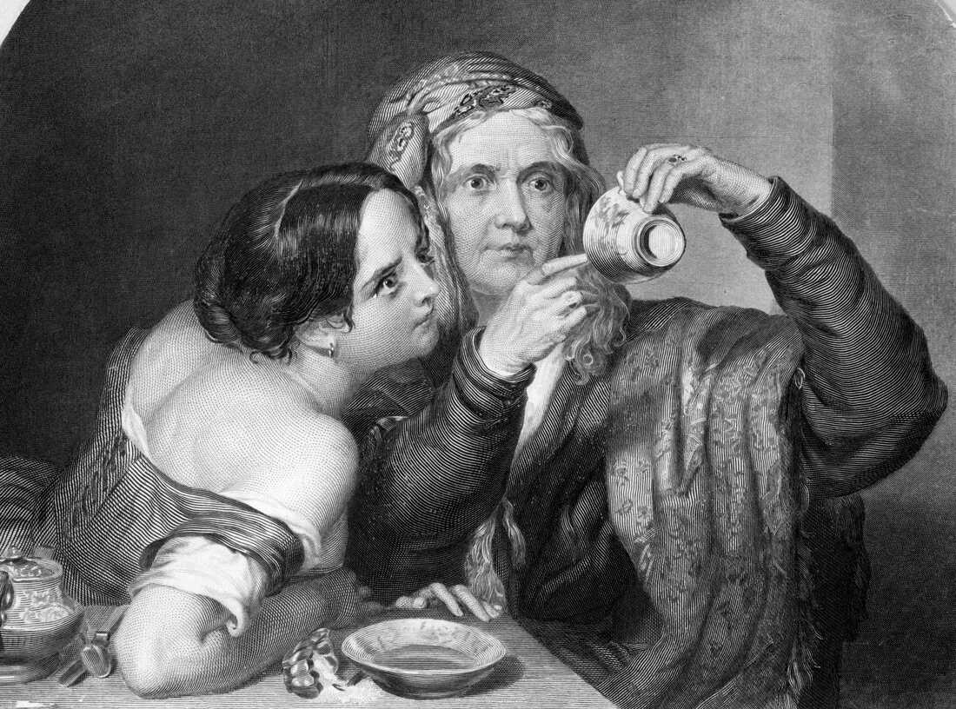
Notes:
For hundreds of years, people seriously thought they could predict the future by studying tea leaves...

Slide 4
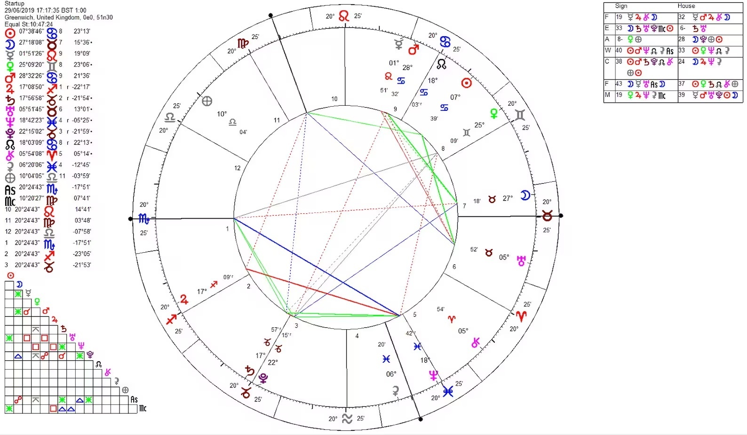
Notes:
… or astrology. [Short pause]
The astrological chart is possibly an inspiration for stock technical analysis.

Slide 5
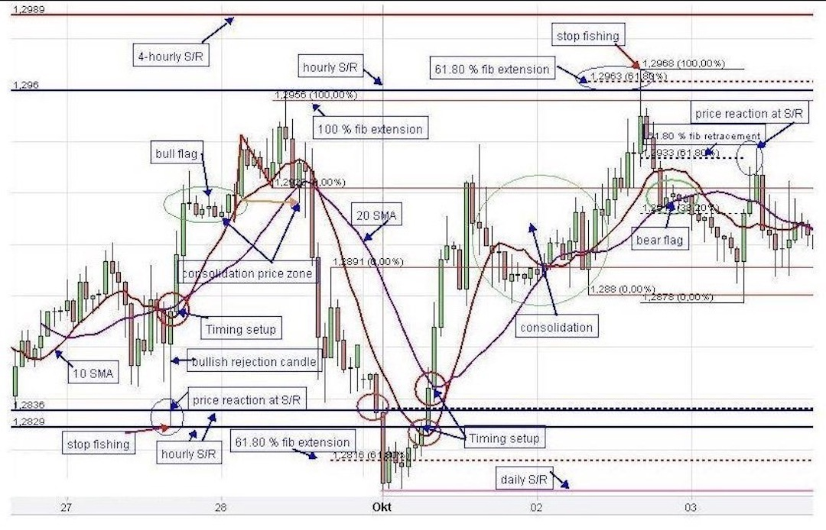
Notes:
Can the lines and arrows depicting the motions of the support and breakout levels in this complex technical analysis also help one predict the future? Or is this just financial astrology?
Is it possible by taking a step back and looking at small-scale trends, that we can indeed see what the future holds?
Not months ahead. Maybe just next week.
We believe there are better ways of forecasting.
We believe that a time-sequenced analysis of a stock might predict short-term trends in stock price.

Slide 6
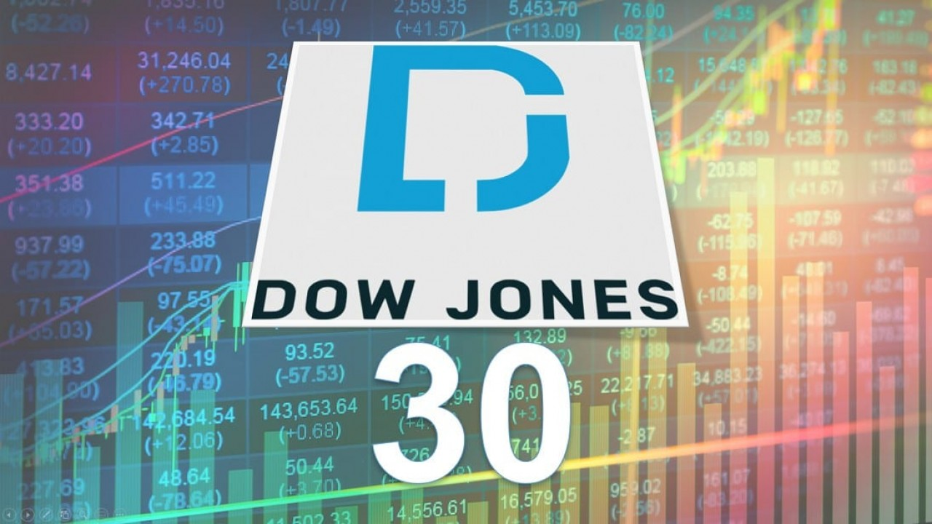
Notes:
We would start with the Dow30 industrial average and follow them for a period.
This is a small but defined sample from all available stock data.
We would then use that data to see whether there is a relationship between the current price of a stock and its value in the recent past.
We went through an exercise of analyzing 30 stocks over a 6-month period to prove or disprove that a time-sequenced analysis of a stock might predict short-term trends in stock price, [pause]
But I will ask Akram to explain how we did that.

Slide 7

Methodology
What we did to analyze the data
Notes:
Thank you Daniel.
Hello, my name is Akram Mahmoud and I would like to share with you how we went about analyzing the data and got to the results Gary will share with you.
We looked at machine learning approaches, but training a model, such as LSTM, on this limited dataset, without access to transfer learning, would not be feasible.
Our strategy was to plot a moving average of various parameters and determine which are most closely associated with next week’s opening price. Our intuition was that the moving average would reveal a relationship between the current price of a stock and its value in the recent past. We then looked at various machine learning algorithms, but our data set was not large enough. To give meaningful results.

Slide 8

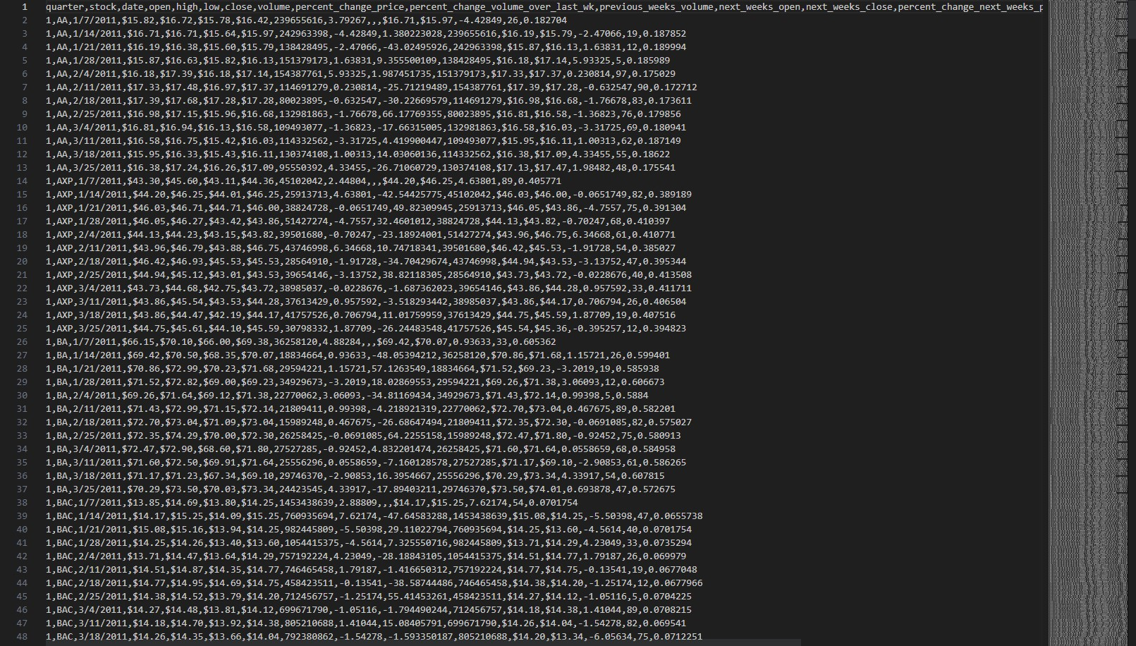
Notes:
Our study delves into a dataset obtained from the University of California, Irvine, containing stock market prices from companies like AA, AXP, BA, and so on.
The dataset consists of 750 records comprising information from 30 companies listed on the DOW Industrial Index at that time for the period from January to June 2011, and it includes 24 weekly data points for each company split into 2 quarters.
This dataset provided various parameters like weekly opening price, weekly high price, weekly low price, closing price, volume of trades, price change over the week, and many others.
We took some data from a study that was done in 2014 by James Brown after which he donate the data to the public domain.
The data consists of 750 records comprising information from 30 companies listed on the DOW Industrial Index at that time and The covered two quarters from January 7 through June 24, 2011.
Each record consists of amongst others, the company ticker, the closing date for the week, the opening, high, low, and closing prices for that week.

Slide 9
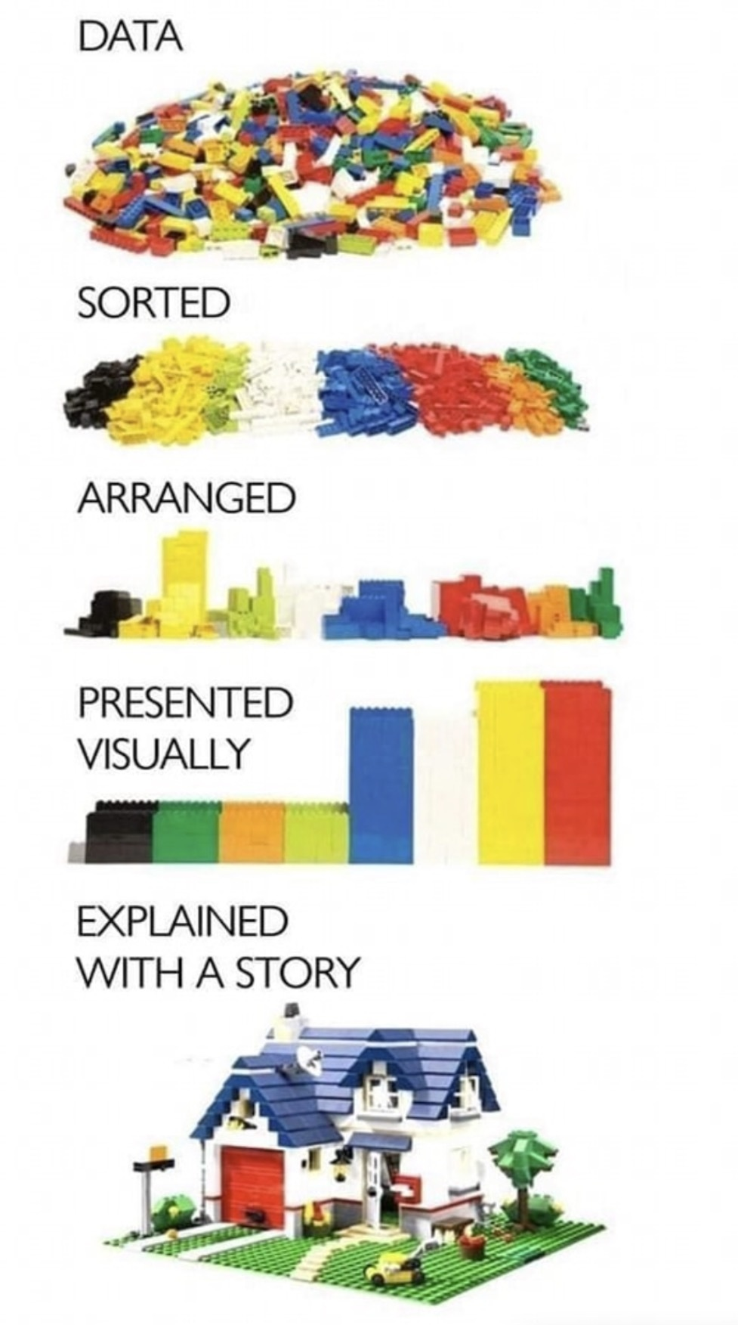
Notes:
This dataset is raw, disorganized but the building blocks of what we believe will be a nice story.
We can put these together to create the story.
Can we assemble these pieces together, and put together a story?
How to we approach the problem? Perhaps the answer is not in the lines drawn by a ruler. But the curves that the arrows trace.

Slide 10
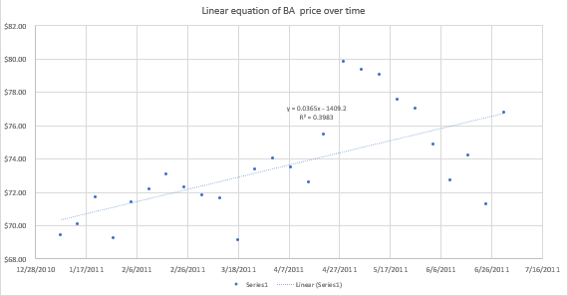
Notes:
We thought of doing a simple linear analysis of the data but saw that the individual stock price graph over a month time period was irregular, not lending itself to linear analysis. We looked at the weekly distribution of the stock prices, ask-bid distributions, high-low prices, and candlestick charts showed that there was no hope of getting a normal distributions around open, high, low and closing prices.
Given the time-sequenced nature of the data, we explored machine learning approaches using time-sequence analysis algorithms such as time-sequenced regression and ARIMA models.
We found the moving average model to be particularly useful due to its straightforward concepts and low computational demands.

Slide 11
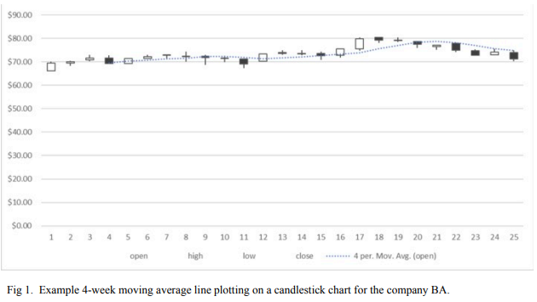
Notes:
To illustrate, let's consider a 4-week moving average line plotted on a candlestick chart for the company Boeing. We aimed to determine which moving average parameters of the data are most closely associated with the next week's opening price. We initially considered using Keras/Tensorflow for analysis, but due to dataset size restrictions, we turned to Microsoft Excel's moving average functionality instead.

Slide 12


import matplotlib.pyplot as plt
import numpy as np
import pandas as pd
import statsmodels.api as sm
Data Analysis – Moving Average
Forecast
Notes:
Microsoft Excel, a spreadsheet software app by Microsoft Corp, offers a comprehensive set of statistical tools, including the ability to calculate moving averages. Our approach was to average the last 4 data points, achieving an optimal balance between under and over-smoothing.
Excel does not offer ordinary least squares analysis and we turned to Python and the statsmodel library to further analyze the data.
For regression analysis, we used the statsmodels library in a Jupyter Lab environment, supplemented by Python, Numpy, Matplotlib, and Pandas. We pre-processed the data by removing rows with missing values and decided against normalizing the data points as it wouldn't impact the accuracy of moving average calculations.
Our ultimate goal was to predict the next week's prices by analyzing which feature was most closely associated with the following week’s opening prices, and which were least correlated.
We compared these predictions with the feature set of the final week using multilinear regression using Python code.

Slide 13
Using Excel and Python programs we evaluated each company separately.
First calculating 4-week averages using Excel, and then creating multilinear regression models using Python.
Notes:
In summary,
Using Excel and Python programs we evaluated each company separately calculating a 4-week moving average for each week.
We then created a multilinear regression model which gave us the ability to further analyze the data and compare that with the feature set of the final week.
But, I do not want to steal Gary’s thunder and would like to hand over to Gary now to discuss the results.

Slide 14


Interpretation of the Results
Putting it all together
Notes:
Thank you, Akram, And now we turn to the analysis portion of our presentation.
In this section, I will review the data that we had generated using the methods described in the previous section, and walk you through our analysis. In the beginning, it’s good practice to start with a visualization of the data. Therefore, we generated scatterplots to see how closely each feature vector (i.e. open, low, high, close) aligned with the target vector, that is, the opening price of the last week in our dataset.

Slide 15
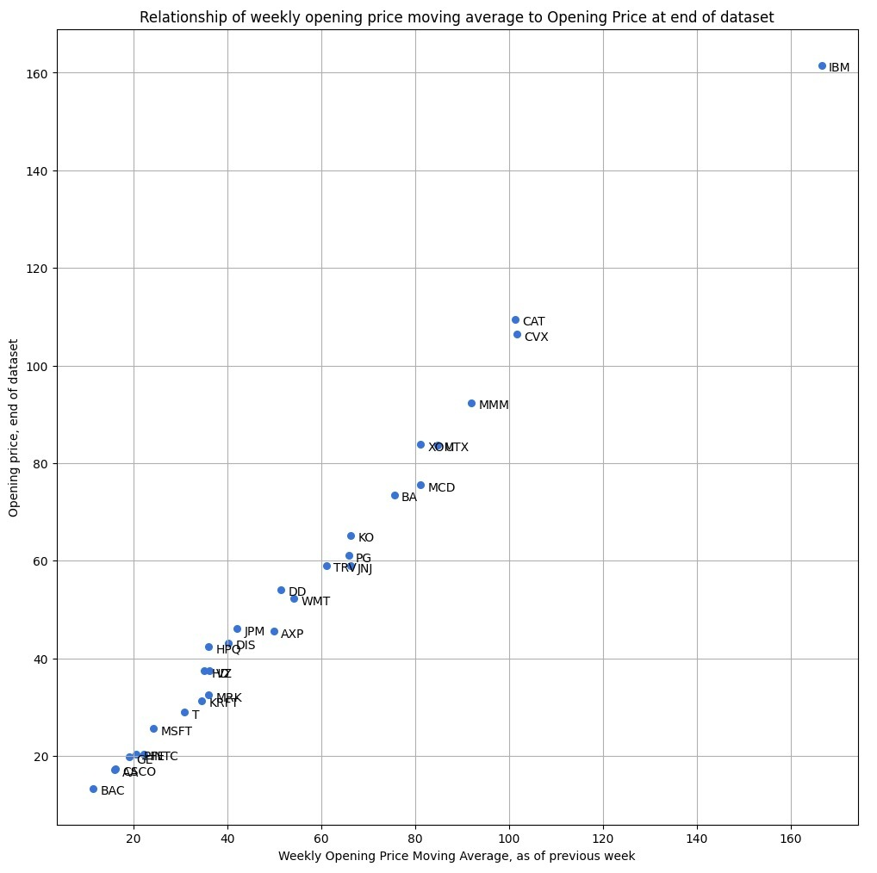
Notes:
Here’s a graph showing the relationship between the moving average figure as calculated for the penultimate week of our dataset, compared with opening price of the last week of our dataset. As you can see there is a fairly nice linear correlation. Although IBM was an outlier, it still tracked the linear relationship.

Slide 16
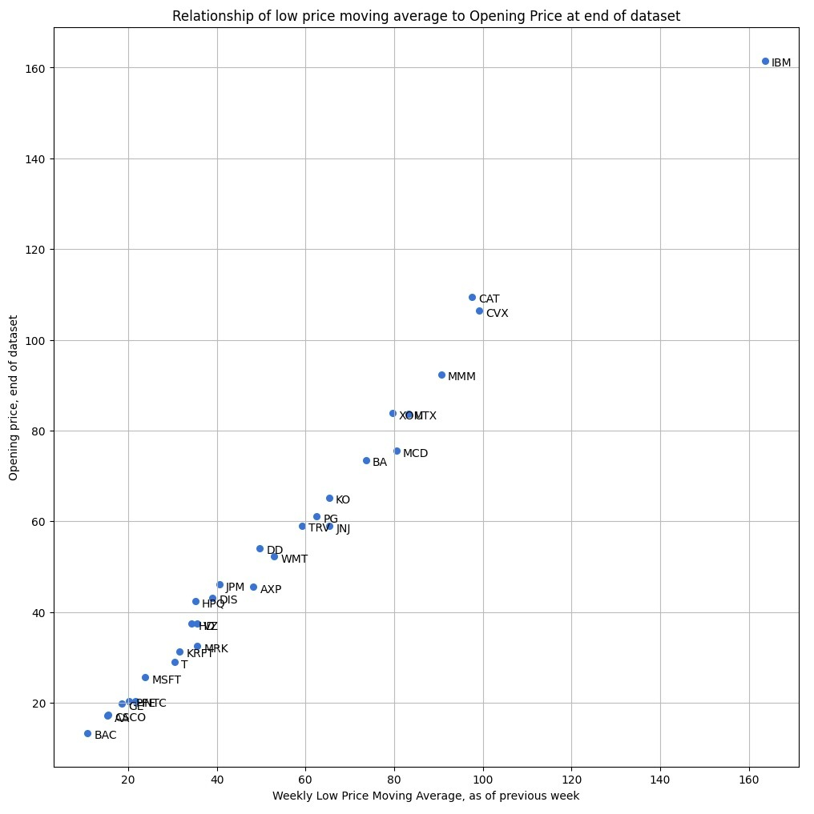
Notes:
And here is a graph showing the moving average of the weekly low price of each stock, compared with the opening price of the last week in our dataset. Again, quite linear.

Slide 17
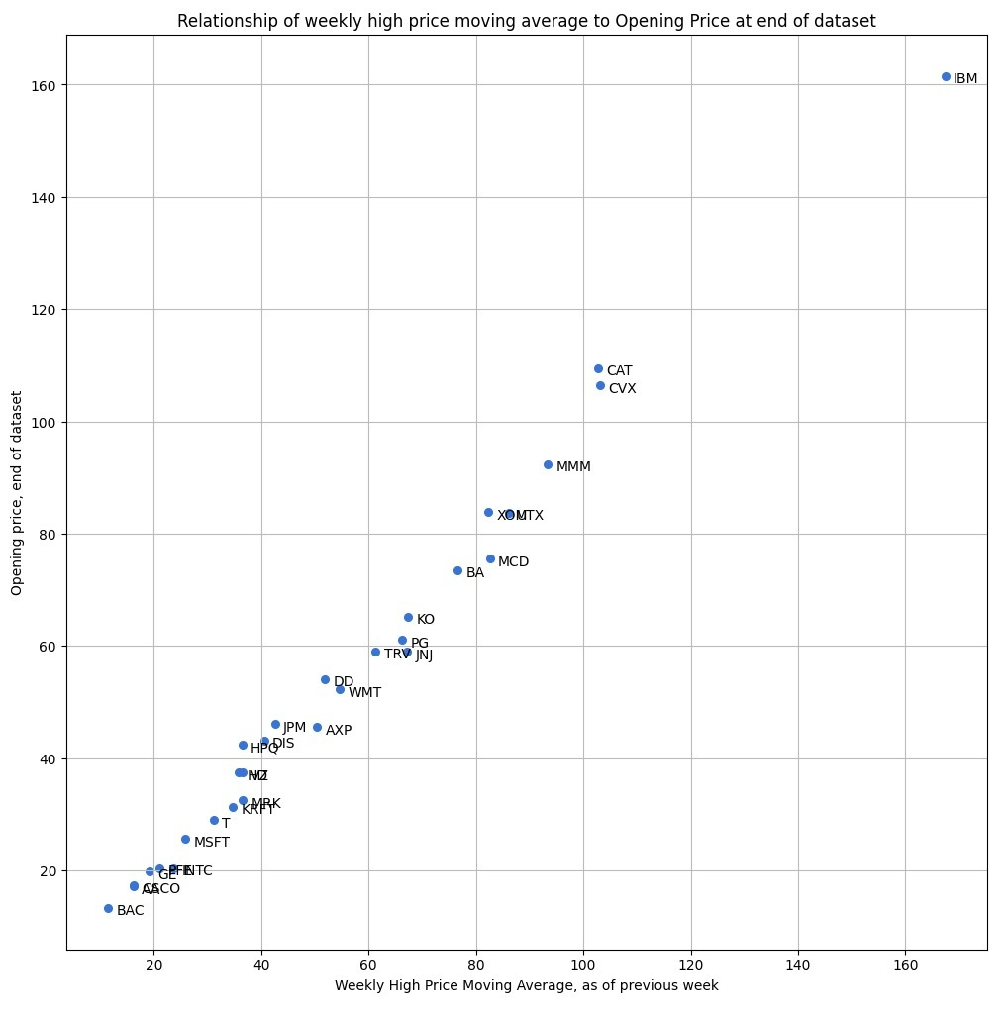
Notes:
And this graph shows the weekly high moving average scatterplot. Again, very nice correlation.

Slide 18
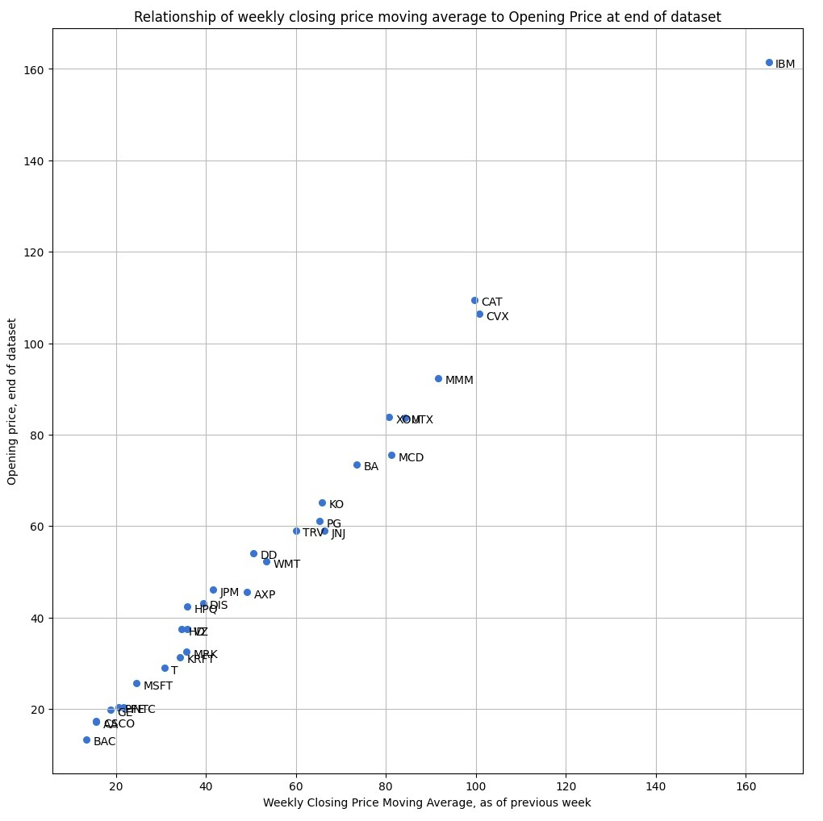

Notes:
And finally, the weekly closing price moving average scatterplot. As before, there is a fairly close correlation with following week’s opening price.
Now, on to the major attraction, the multivariable linear regression analysis.

Slide 19
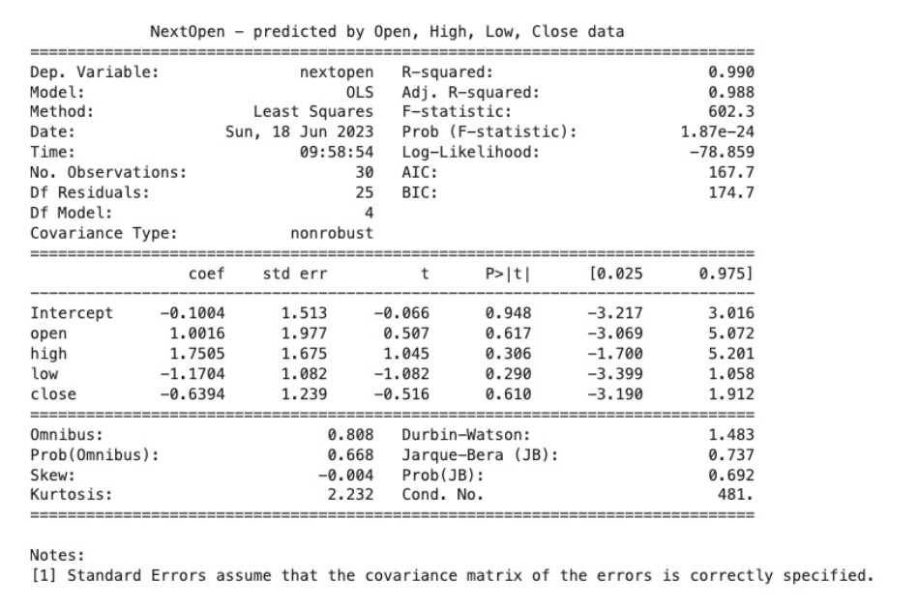

Notes:
The first thing I call your attention to is the R-square value, <CLICK>
which is very close to one, indicating a nice linear relationship between each of the features and the response variable, which is the following week’s opening price. <CLICK>
The adjusted R-squared is a measure of how well each feature contributes to predicting the opening price. That the adjusted R-squared is not very different from the R-squared value indicates that each feature variable was relevant as a predictor. <CLICK>
The F-statistic, which is a measure of how well the model as a whole allows us to determine how well the feature variables we selected are jointly, and that is the key word, jointly, are significant in explaining the variance of the dependent variable, which is the opening price of the last week of the dataset.
As you can see, the F-statistic is high, and the P-value of the F-statistic <CLICK> is exceedingly low. We can confidently take the stance that our variables are at least jointly significant in explaining the linearness in the scatterplots we observed. <CLICK>
Looking good so far. <CLICK>
However, the high Condition Number <CLICK> which is much greater than 30, indicates multicollinearity, which is that at least some of the features share dependency. <CLICK>
And this could explain why in the multivariable linear regression, <CLICK> none of the features achieved statistical significance alone as a predictor of the target opening price variable. That is, none of the P-values were less than 0.05.
The lowest P-values were seen with the weekly high and low features, which respectively showed positive and negative association with opening price, but again, not to a statistically significant degree. <CLICK>

Slide 20
Summary
The moving averages of the opening, high, low, and closing prices do not predict well the opening price of the stock the following week
Factors other than the four prices may influence stock prices over the weekend (such as Asian markets and banks)
Adjusting the number of periods in the moving average might better capture trends
The weak association noted with high and low weekly prices suggests potential for refinement to enhance a possible underlying predictive power.
Other features, such as trading volume, % price change, or intraday trading patterns are considerations for future exploration.
Notes:
Our simple analysis of calculating moving averages as a means of time-sequenced data analysis revealed the a 4-period simple moving average over the Dow30 stocks was not sufficiently predictive of short-term future market movement.<CLICK>
We suspect that changes in market sentiment over the weekend as well as changes in the global market, especially in Asia, could affect Monday’s opening price.<CLICK>
It is possible that increasing the number of periods in the moving average calculation might increasing smoothing and better capture long-term direction. <CLICK>
We observed positive association with weekly high prices, and negative association with weekly low prices, which makes sense, and invites efforts to refine the potential predictive power of these features. <CLICK>
Finally, other readily accessible trading data are available, which could also be considered in a predictive model.

Slide 21
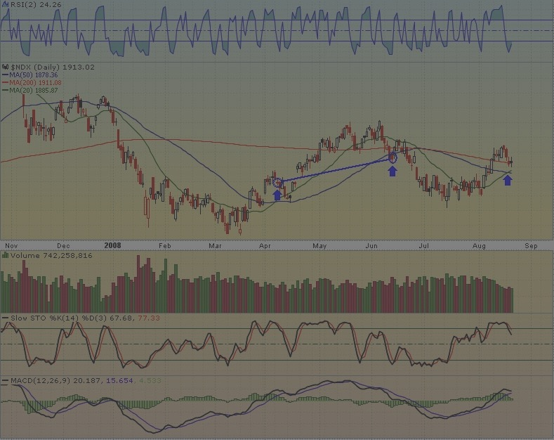
Thank you
Notes:
We thank you for your attention and hope you enjoyed this presentation.

Slide 22
Acknowledgements
University of San Diego
The Shiley-Marcos School of Engineering
Dr. Ebrahim Tarshizi and his staff
Dallin Munger – our lecturer
The team members who contributed to this paper and presentation
Daniel Ackermann
Gary Takahashi
Akram Mahmoud

